Slide 1

Quantum Battery Optimization through Quantum Machine Learning Techniques
Vu Tuan Hai¹, Vo Minh Kiet², Le Vu Trung Duong¹,
Pham Hoai Luan¹, Le Bin Ho^{3, 4}, and Yasuhiko Nakashima1
¹ Nara Institute of Science and Technology,, Japan.
² University of Information Technology, Vietnam National University, Vietnam.
³ Frontier Research Institute for Interdisciplinary Sciences, Tohoku University, Japan.
⁴ Department of Applied Physics, Graduate School of Engineering, Tohoku University, Japan.
Presenter: Vu Tuan Hai vu.tuan_hai.vr7@naist.ac.jp

Slide 2
Outline
Introduction
Method
Experiement
Conclusion

Slide 3
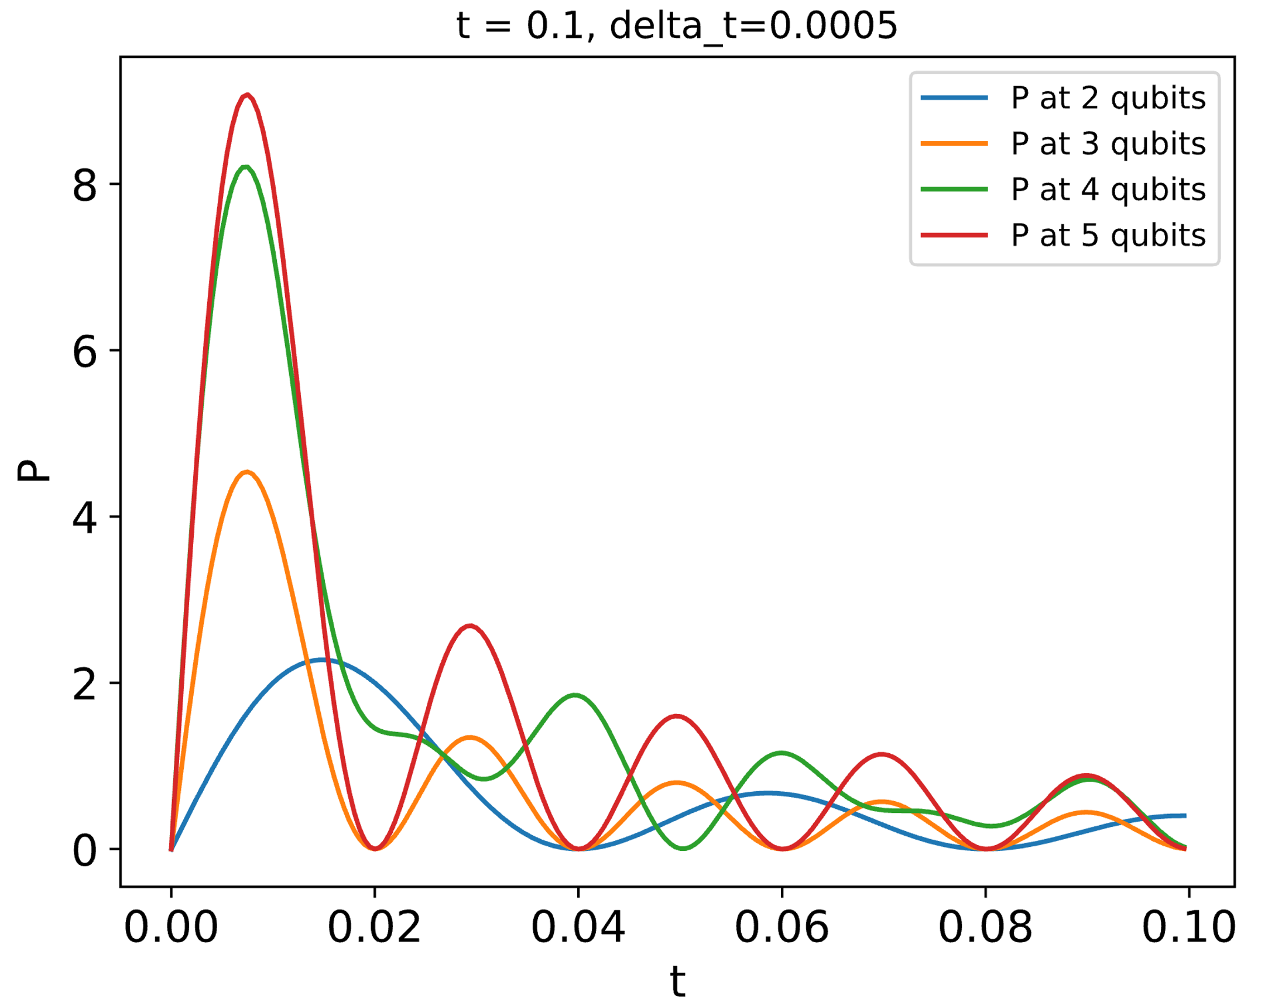
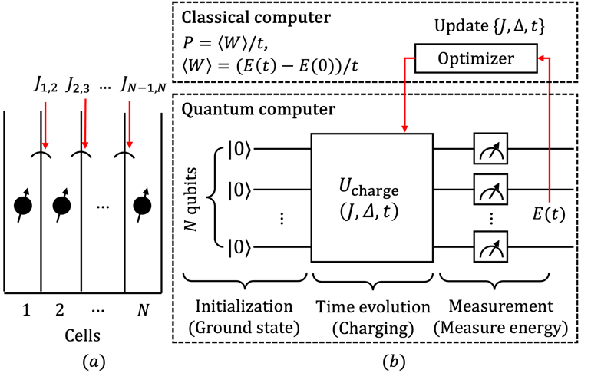

1. Introduction: quantum battery
Figure 1. Charging process,
Power ($P$) versus charging time $t$
Figure 2. 1-D quantum battery model

Slide 4
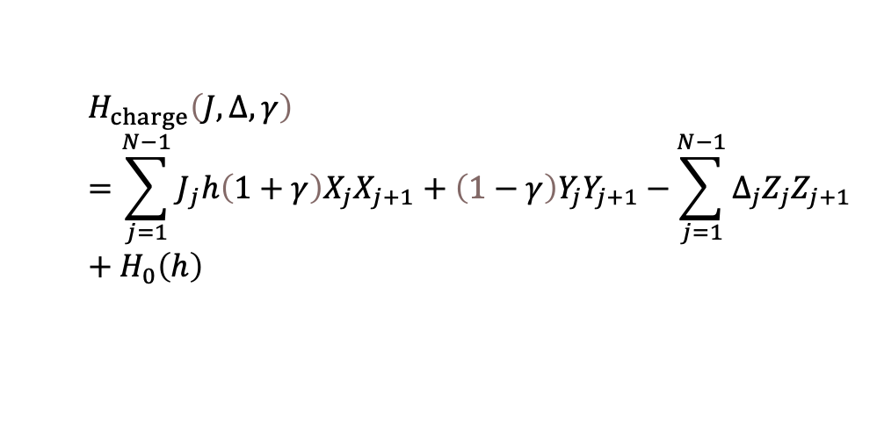
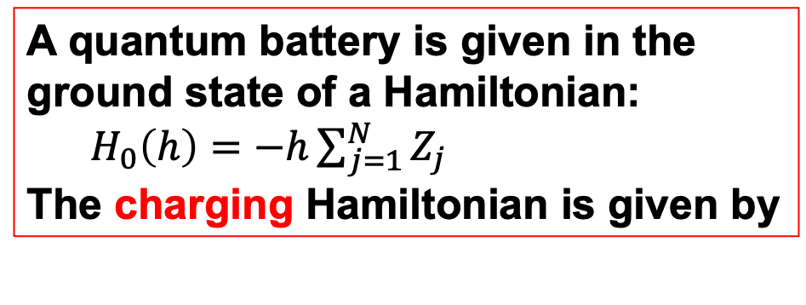


1. Introduction: quantum ML model
A quantum battery is given in the ground state of a Hamiltonian:
$H_{0}\left(h\right)=−h\sum_{j=1}^{N}{Z_{j}}$
The charging Hamiltonian is given by
$$H_{charge}\left(J,Δ,γ\right)=\sum_{j=1}^{N−1}{J_{j}h\left(1+γ\right)X_{j}X_{j+1}+\left(1−γ\right)Y_{j}Y_{j+1}−}\sum_{j=1}^{N−1}{Δ_{j}Z_{j}Z_{j+1}}+H_{0}\left(h\right)$$
Figure 3. A quantum machine learning (QML) algorithm for optimizing battery’s power. [1-3]
Optimizing $\left\{ J,Δ\right\}$ mean we have a better battery
How to optimize $\left\{ J,Δ\right\}$?

Slide 5



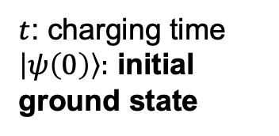
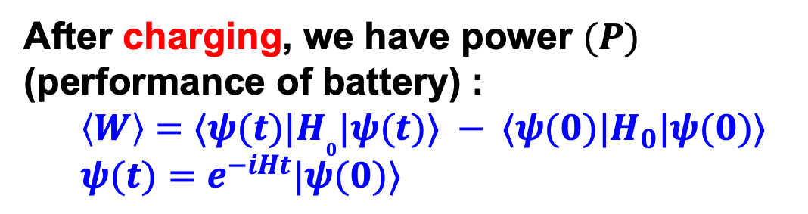

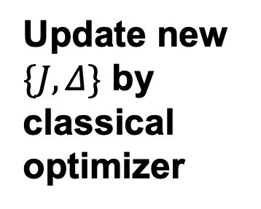
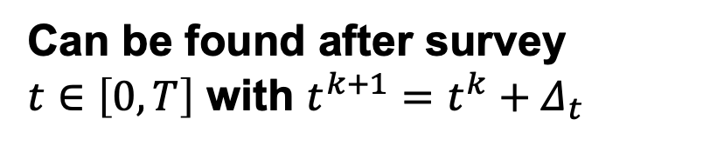



2. Method
Quantum
Classical
After charging, we have power $(P)$ (performance of battery) :
$\left\langle W\right\rangle =⟨ψ(t)|H_{0}|ψ(t)⟩ − ⟨ψ(0)|H_{0}|ψ(0)⟩$
$ψ(t)=e^{−iHt}|ψ(0)⟩$
$t$: charging time
$\left|ψ\left(0\right)\right\rangle :$ initial ground state
Calculate directly
$${\left(J | Δ\right)}^{t+1}={\left(J | Δ\right)}^{t}−α∇ℒ$$
Update new $\{J,Δ\}$ by classical optimizer
$P=⟨W⟩/t$
Can be found after survey
$t∈\left[0, T\right]$ with $t^{k+1}=t^{k}+Δ_{t}$
$P_{max}>P ∀t$
$$∇ℒ$$
We want to find “max” of $P_{max}$
Calculate gradient
$P_{max}^{∗}>P_{max} ∀J,Δ$
$ℒ\left(J, ∆, γ\right)=−|P_{max}|$

Slide 6
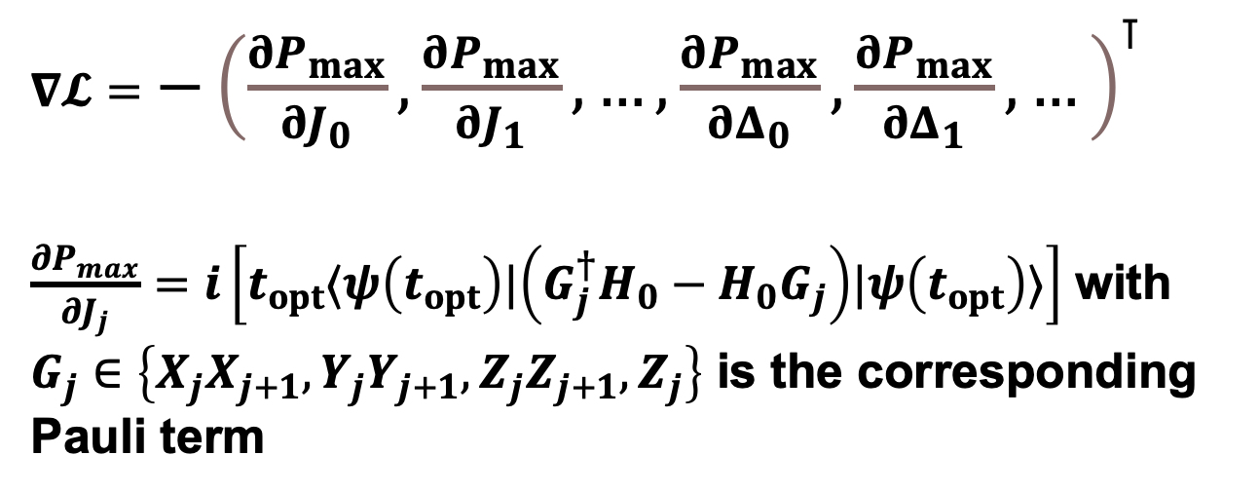
2. Method
$∇𝓛=$ $−{\left(\frac{∂P_{max}}{∂J_{0}},\frac{∂P_{max}}{∂J_{1}},…,\frac{∂P_{max}}{∂Δ_{0}},\frac{∂P_{max}}{∂Δ_{1}},…\right)}^{⊺}$
$\frac{∂P_{max}}{∂J_{j}}=i\left[t_{opt}⟨ψ\left(t_{opt}\right)|\left(G_{j}^{†}H_{0}−H_{0}G_{j}\right)|ψ\left(t_{opt}\right)⟩\right]$ with $G_{j}∈\left\{X_{j}X_{j+1},Y_{j}Y_{j+1},Z_{j}Z_{j+1},Z_{j}\right\}$ is the corresponding Pauli term

Slide 7
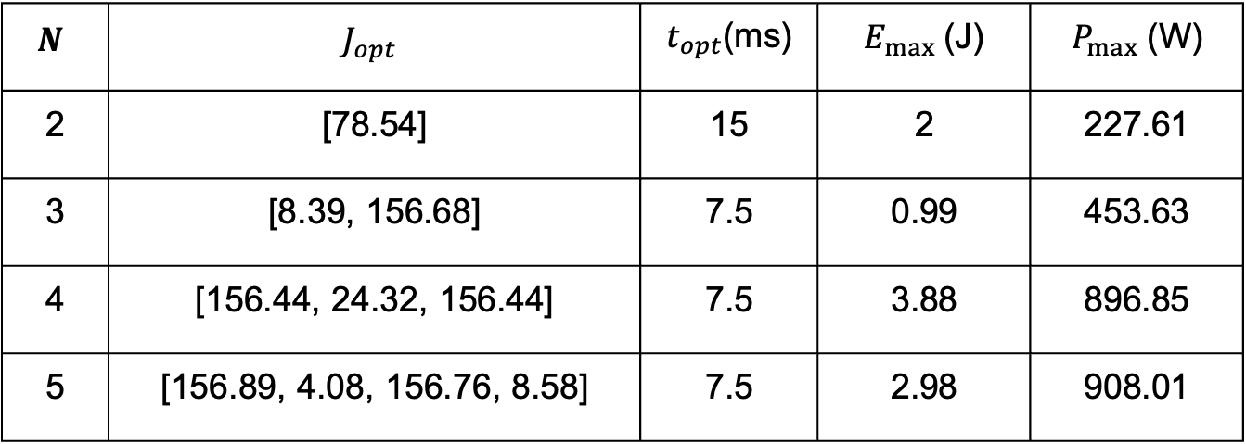
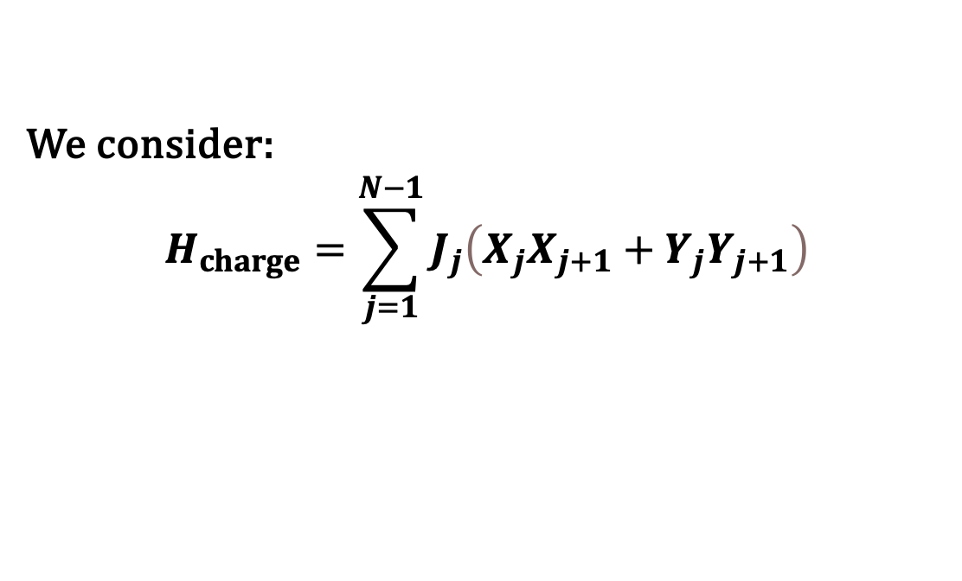
3. Experiment
TABLE I. Experimental result with $∆t=50 \left(ms\right), t∈\left[0, 5\right](s).$
$$N$$ | $$J_{opt}$$ | $t_{opt}$(ms) | $E_{max}$(J) | $P_{max}$(W)
2 | [78.54] | 15 | 2 | 227.61
3 | [8.39, 156.68] | 7.5 | 0.99 | 453.63
4 | [156.44, 24.32, 156.44] | 7.5 | 3.88 | 896.85
5 | [156.89, 4.08, 156.76, 8.58] | 7.5 | 2.98 | 908.01
We consider:
$$H_{charge}=\sum_{j=1}^{N−1}{J_{j}\left(X_{j}X_{j+1}+Y_{j}Y_{j+1}\right)}$$

Slide 8
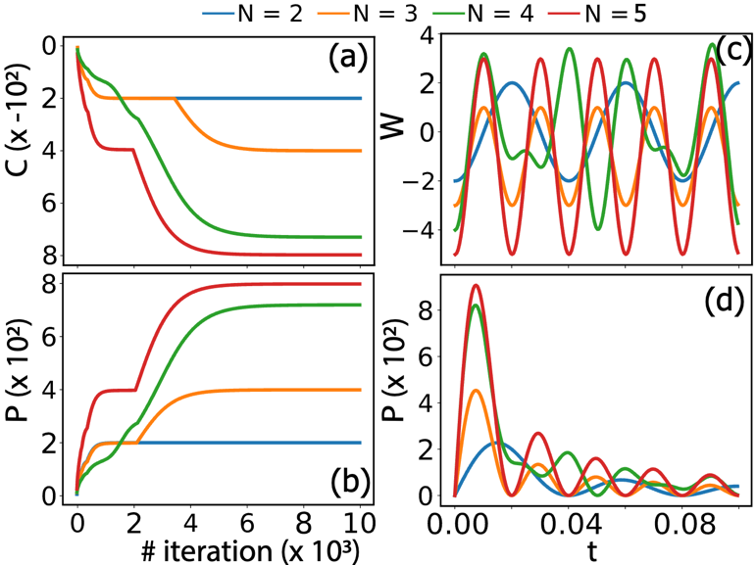
3. Experiment
Figure 4. (a) Plot of loss function versus the iteration. (b) Plot of power versus the iteration. (c) Energy as a function of time. (d) Power as a function of time.

Slide 9
4. Conclusion
Optimizing quantum batteries using quantum machine learning is a new frontier in energy storage.
We are testing more complex model, such as 2-D or 3-D battery.
Try to optimize battery’s structure (its Hamiltonian)

Slide 10
Acknowledgment
This work was supported by JST-ALCA-Next Program Grant Number JPMJAN23F5, Japan. The research has been partly executed in response to support of JSPS, KAKENHI Grant No. 22H00515, Japan.

Slide 11
References
[1] J. Biamonte, P. Wittek, N. Pancotti, P. Rebentrost, N. Wiebe, and S. Lloyd, "Quantum machine learning," Nature, vol. 549, no. 7671, pp. 195-202, Sep 2017.
[2] F. Campaioli, S. Gherardini, J. Q. Quach, M. Polini, and G. M. Andolina, "Colloquium: Quantum batteries," 2023.
[3] D. Rossini, G. M. Andolina, D. Rosa, M. Carrega, and M. Polini, “Quantum advantage in the charging process of sachdev-ye-kitaev batteries,” Phys. Rev. Lett., vol. 125, p. 236402, Dec 2020.
[4] D. T. Hoang, F. Metz, A. Thomasen, T. D. Anh-Tai, T. Busch, and T. Fogarty, “Variational quantum algorithm for ergotropy estimation in quantum many-body batteries,” Phys. Rev. Res., vol. 6, p. 013038, Jan 2024.
[5] S. Juli`a-Farr ́e, T. Salamon, A. Riera, M. N. Bera, and M. Lewenstein, “Bounds on the capacity and power of quantum batteries,” Phys. Rev. Res., vol. 2, p. 023113, May 2020.
[6] J.-Y. Gyhm, D. Rosa, and D. ˇSafr ́anek, “Minimal time required to charge a quantum system,” Phys. Rev. A, vol. 109, p. 022607, Feb 2024.

